Slide 1

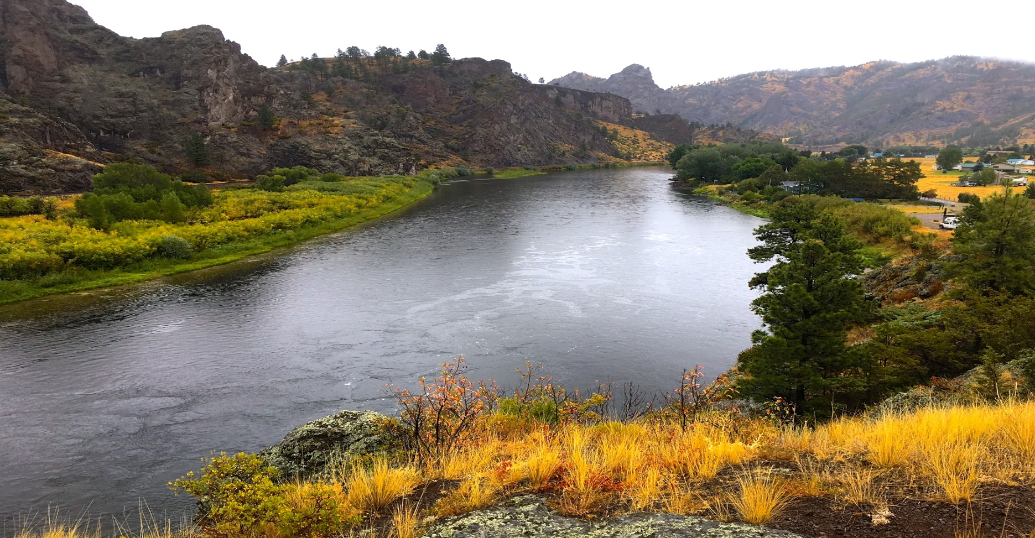
Upper Missouri River Watershed Project
2022 Noxious Weed Trust Fund
Grant Hearing

Slide 2
Missouri River Project Area
35 miles river corridor - Holter Lake to Cascade
3 miles up Dearborn River and 12.5 miles up Stickney Creek
55,000 total acres
16 Fishing access sites
79% private, 11% public

Slide 3
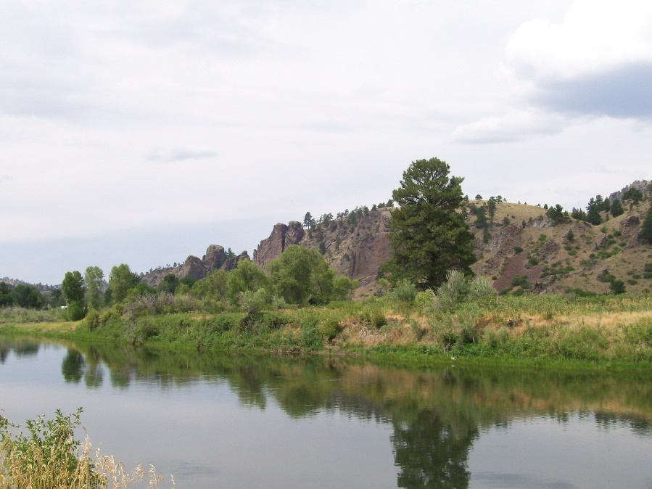
2022 Treatment Plan
Treat 1546 acres
Islands -- Holter Dam to Eagle Island ~60 acres by boat/back pack
Landowner treatments
Aerial/Drone
UTV
Spot treatments
Volunteer weed pull
Biocontrol agents
Survey project area
Eagle Island (21 acres)

Slide 4
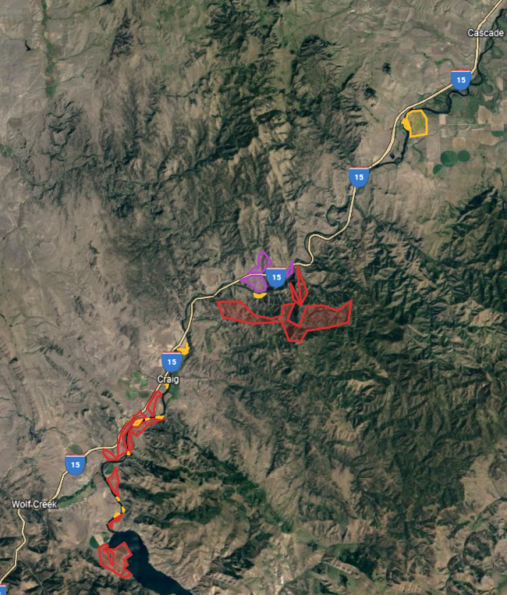
Program Objectives
2021/2022
2022/2023
2023/2024
Expand treatment areas downstream
Establish community weed groups
Raise matching funds
Educate and engage river community

Slide 5
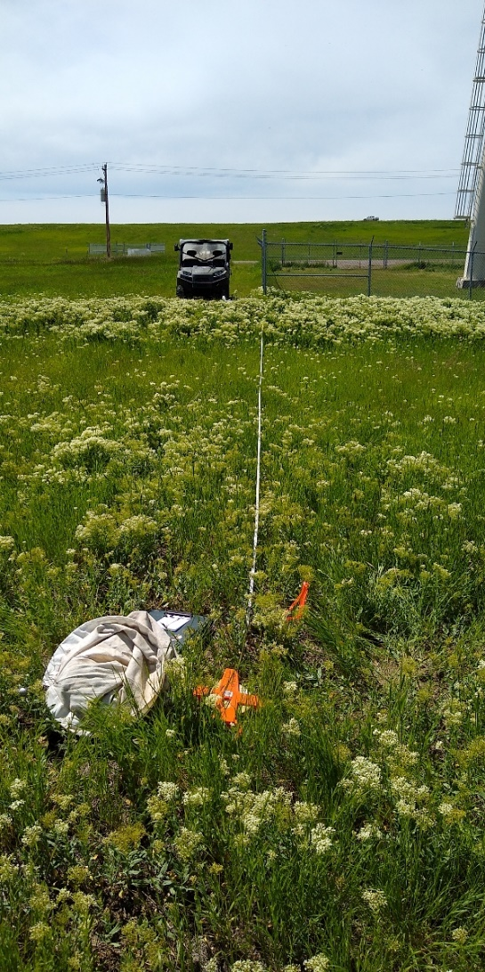
Monitoring and Mapping
Standard Impact Monitoring Protocol
Establish permanent sites
Record plant properties
Picture Points
Changes in plant populations
EDDMapS West
Field records/new invasives
Educate new users
Arc/GIS
Map treated areas
Map infestations
Incorporate data points
Include landownership

Slide 6
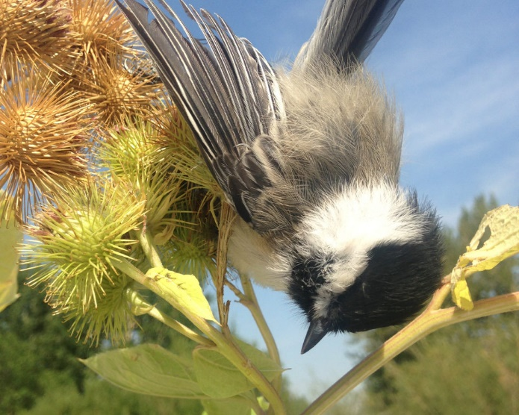
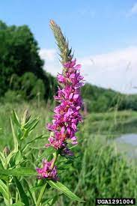
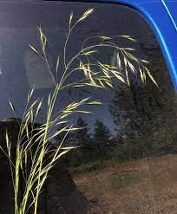
Education
Early Detection/Rapid Response
Social Media Campaign (Facebook, Instagram, Twitter)
Landowners
Fishing Guides/Outfitters
Fly Shops
Outdoor recreation shops (Trxstle, BaseCamp, Capital Sports)
Outdoor Groups (TU, MT Audubon, Scouts of America)

Slide 7
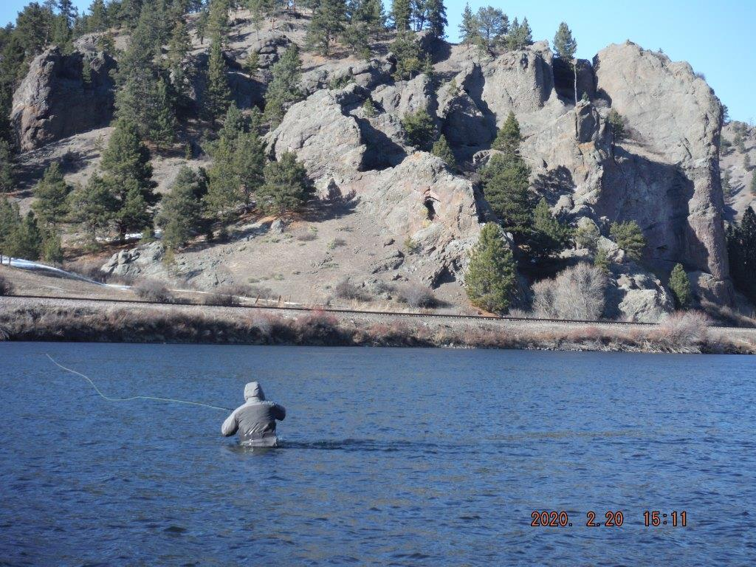
Partners Upper Missouri Watershed Alliance MT Fish, Wildlife and Parks Lewis and County Weed District Cascade County Weed District USDA Forest Service Montana State University Sterling Ranch, OxBow Ranch, Devil’s Kitchen Ranch Headhunters, Montana Trout, Cross Currents, Wolf Creek Angler West River Land Management NorthWestern Energy

