Slide 1

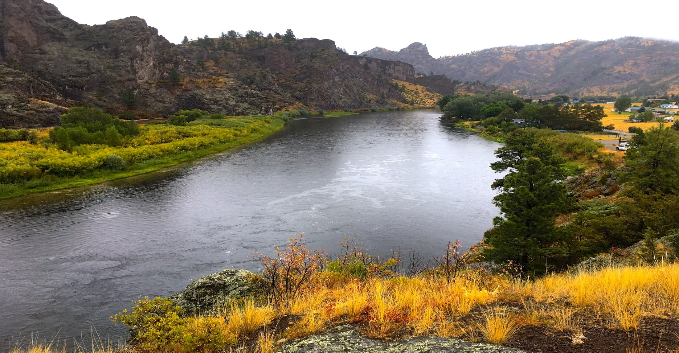
Upper Missouri River Watershed Project
T23-33
2023 Noxious Weed Trust Fund
Grant Hearing

Slide 2
Missouri River Project Area
35 miles river corridor - Holter Lake to Cascade
3 miles up Dearborn River and 12.5 miles up Stickney Creek
55,000 total acres
16 Fishing access sites
79% private, 11% public

Slide 3
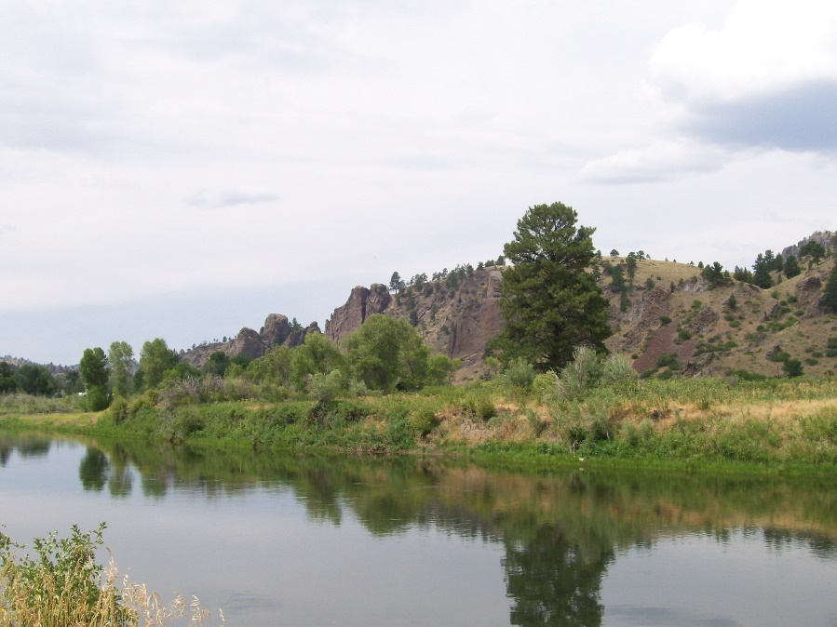
2023 Treatment Plan
Treat 2735 acres
Islands -- Holter Dam to Cascade Bridge by boat/backpack
Landowner treatments
Aerial/Drone
UTV
Spot treatments
Volunteer weed pull
Biocontrol agents
Survey project area
Grant Request:
$72,813
Eagle Island (21 acres)

Slide 4
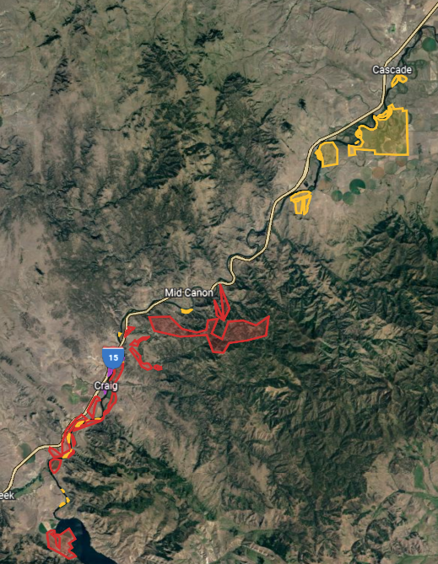
Goals
To decrease spread of noxious weeds throughout the river corridor for the health and benefit of people, livestock, and wildlife
Program Objectives
Expand treatment areas to prevent spread and reintroduction
Establish community weed groups
Raise matching funds
Educate and engage river community

Slide 5
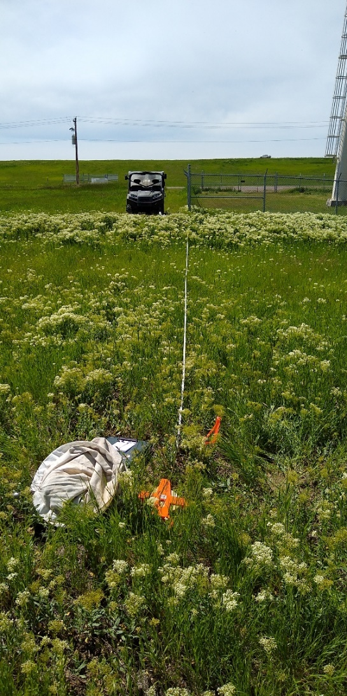
Monitoring and Mapping
Standard Impact Monitoring Protocol
Establish permanent sites
Record plant properties
Picture Points
Changes in plant populations
EDDMapS West
Field records/new invasives
Educate new users
Arc/GIS
Map treated areas
Map infestations
Incorporate data points
Include landownership

Slide 6
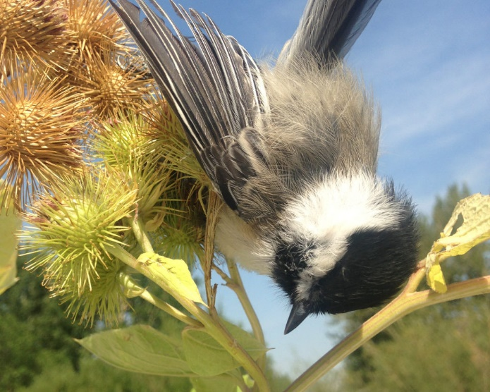
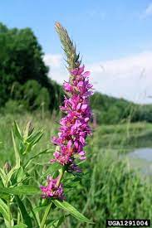
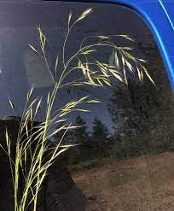
Education
Early Detection/Rapid Response
Social Media Campaign (Facebook, Instagram, Twitter)
Landowners
Fishing Guides/Outfitters
Fly Shops (Craig, Wolf Creek, Cascade, Helena)
Outdoor recreation shops (Trxstle, BaseCamp, Capital Sports)
Outdoor Groups (TU, MT Audubon, Scouts of America)

Slide 7
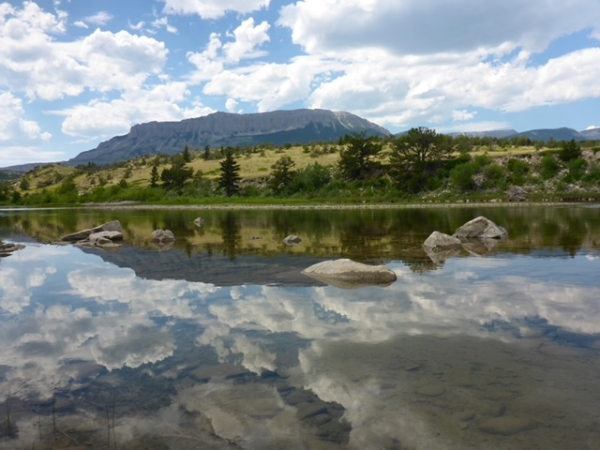
Partners Upper Missouri Watershed Alliance Lewis and Clark and Cascade County Weed Districts MT Fish, Wildlife and Parks USDA Forest Service Montana State University Sterling Ranch, OxBow Ranch, Devil’s Kitchen Ranch, Dana Ranch, Willo Ranch, Canyon Cattle Co, Mortag Ranch Headhunters, Montana Trout, Cross Currents, Wolf Creek Angler West River Land Management, Helena Weed Control, Red Iron Air NorthWestern Energy

