Slide 1

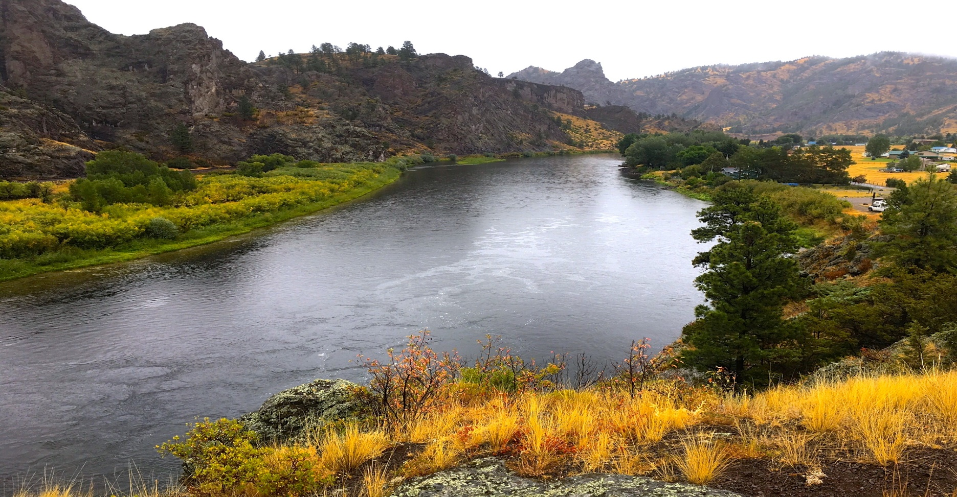
Upper Missouri River Watershed Project
T24-15
2024 Noxious Weed Trust Fund
Grant Hearing

Slide 2
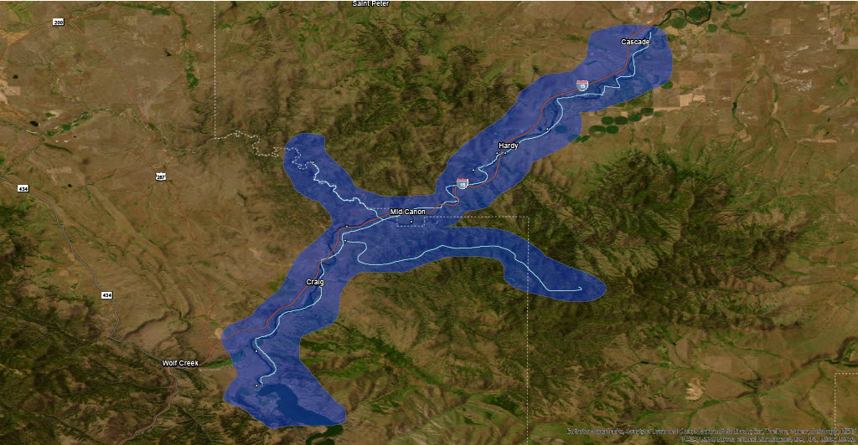
Missouri River Project Area
  35 miles river corridor - Holter Lake to Cascade
  3 miles up Dearborn River and 12.5 miles up Stickney Creek
  55,000 total acres
  16 Fishing access sites
  79% private, 11% public

Slide 3
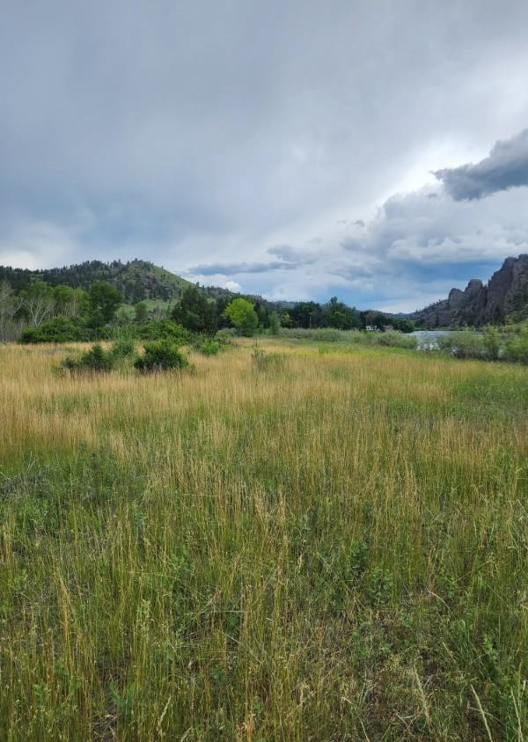
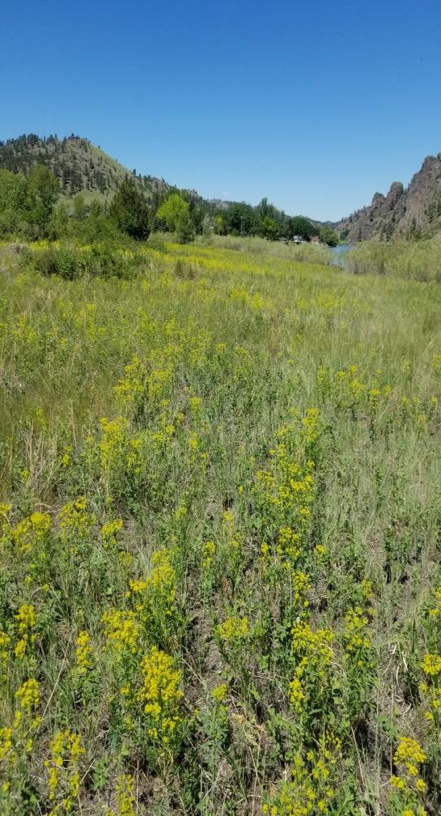
2024 Treatment Plan
Treat 997 acres
Islands - Holter Dam to Cascade Bridge by boat/backpack
Utilize Riparian Management Zone Concept
Landowner treatments
  Aerial/Drone
  UTV
  Spot treatments
Volunteer weed pull
Biocontrol agents
Survey project area
Grant Request:
$49,761
  Eagle Island Before/leafy Spurge infestation
Eagle Island After (21 acres)

Slide 4
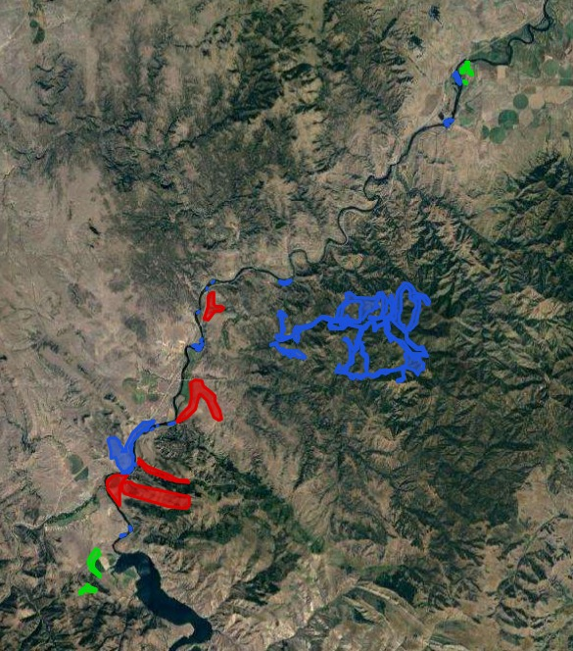
Blue – West River Land Management
Red – Helena Weed Control
Green – Red Iron Air
Program Objectives:
Expand treatment areas to prevent spread and reintroduction of invasive weeds
Establish community weed management groups
Raise matching funds
Educate and engage river community
Program Goal:
To decrease the spread of invasive weeds throughout the river corridor for the benefit of people, livestock, wildlife, and the river itself

Slide 5
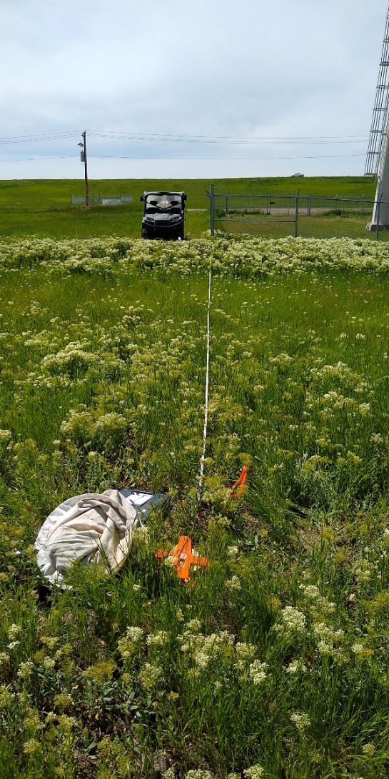
Monitoring and Mapping
Standard Impact Monitoring Protocol (SIMP)
Establish permanent sites
Record plant properties
Picture Points
Changes in plant populations
EDDMaps West
Field records/new invasives
Educate new users
Arc/GIS
Map treated areas
Map infestations
Incorporate data points
Include landownership

Slide 6
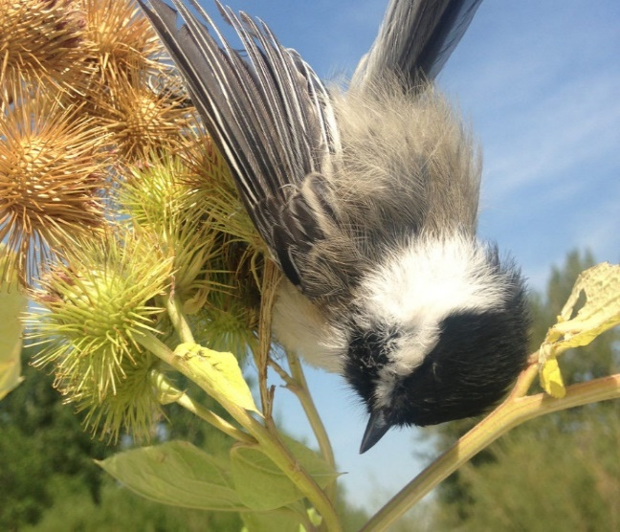
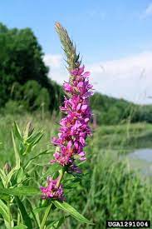
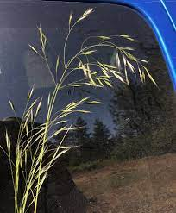
Education
Early Detection/Rapid Response
Social Media Campaign (Facebook, Instagram)
Landowners
Fishing Guides/Outfitters
Fly Shops (Craig, Wolf Creek, Cascade, Helena)
Outdoor recreation shops (Trxstle, BaseCamp, Capital Sports)
Outdoor Groups (TU, MT Audubon, Scouts of America)

Slide 7
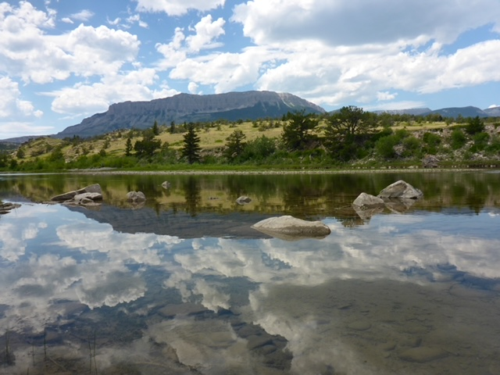
Partners
Upper Missouri Watershed Alliance
Lewis and Clark and Cascade County Weed Districts
MT Fish, Wildlife and Parks
USDA Forest Service
Montana State University
Sterling Ranch, OxBow Ranch, Devil’s Kitchen Ranch, Dana Ranch, Willo Ranch, Canyon Cattle Co, Mortag Ranch
Headhunters, Montana Trout, Cross Currents, Wolf Creek Angler
West River Land Management, Helena Weed Control, Red Iron Air
NorthWestern Energy

