Slide 1

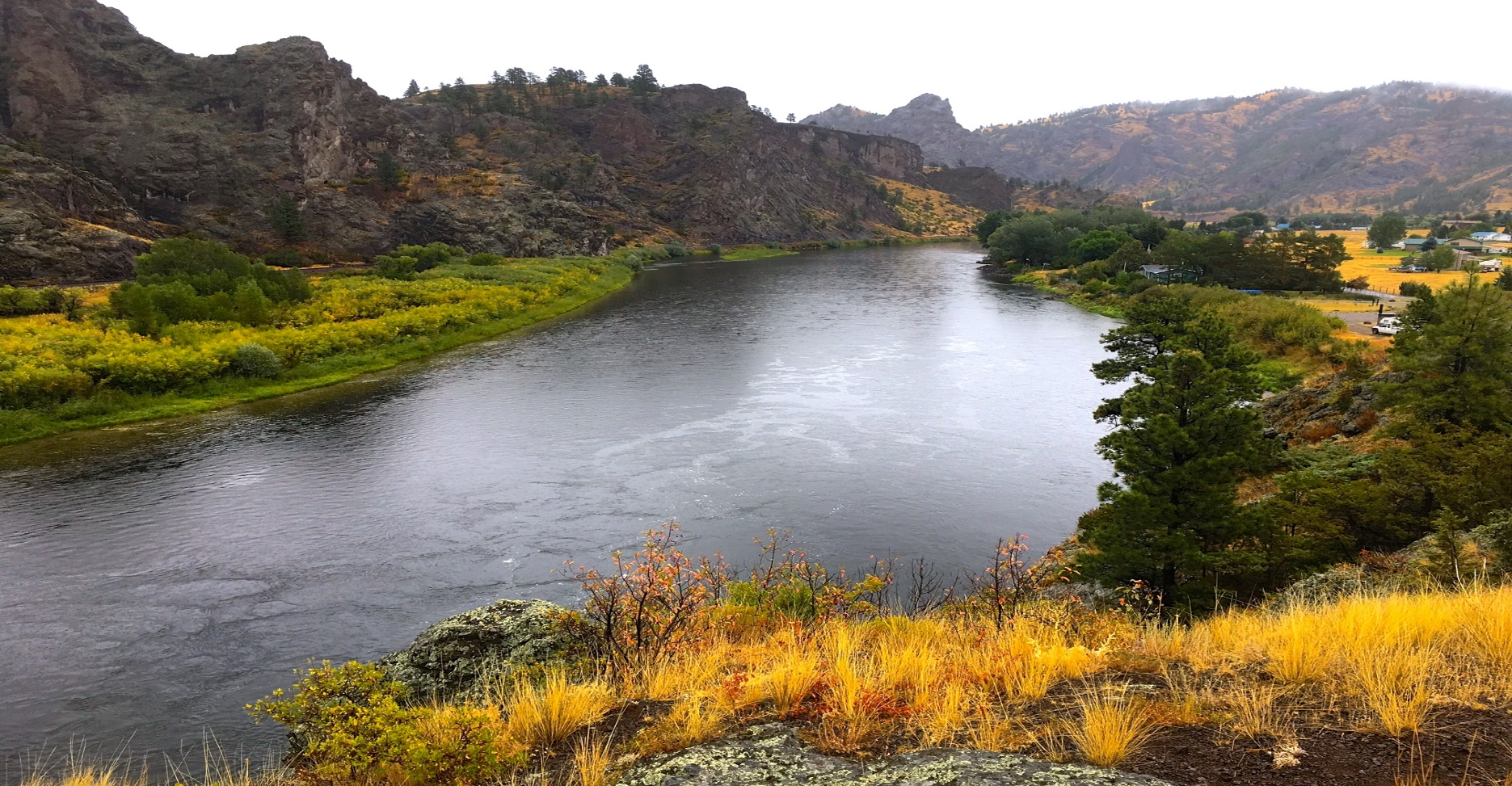
Upper Missouri River Watershed Project
T25-13
2025 Noxious Weed Trust Fund
Grant Hearing

Slide 2
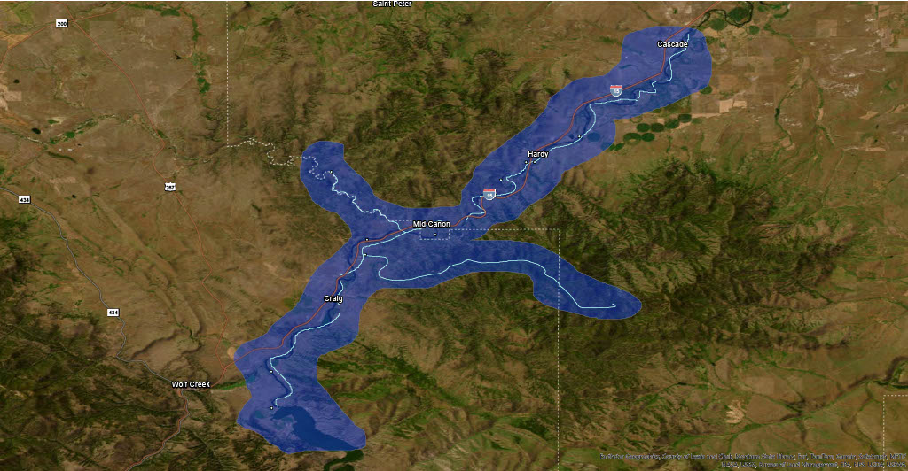
Missouri River Project Area
  35 miles river corridor - Holter Lake to Cascade
  3 miles up Dearborn River and 12.5 miles up Stickney Creek
  55,000 total acres
  16 Fishing access sites
  79% private, 11% public

Slide 3
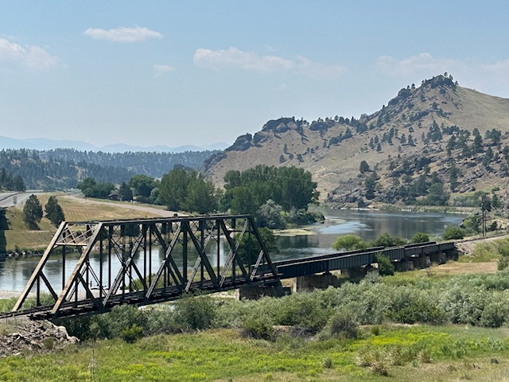
Blue – West River Land Management
Red – Helena Weed Control
Green – Red Iron Air
Program Goal:
To decrease the spread of invasive weeds throughout the river corridor for the benefit of people, livestock, wildlife, and the river itself
Program Objectives:
Expand treatment areas to prevent spread and reintroduction of invasive weeds
Establish community weed management groups
Raise matching funds
Educate and engage river community

Slide 4
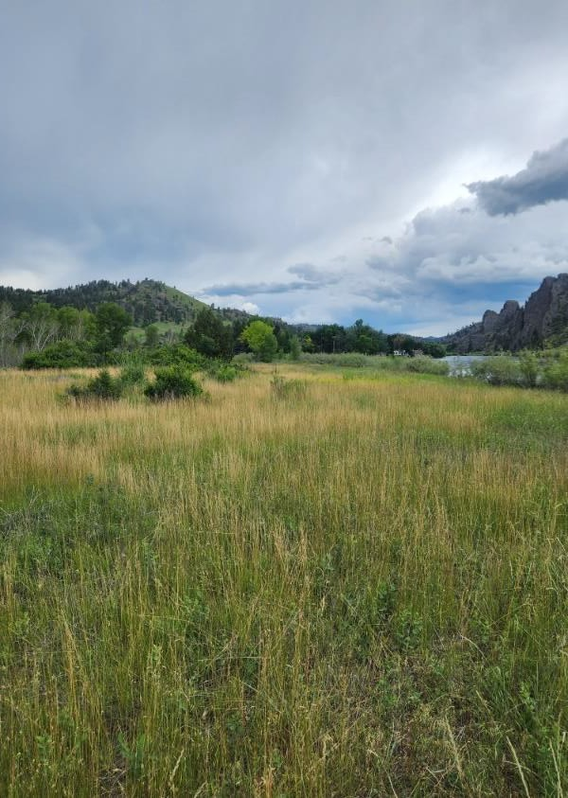
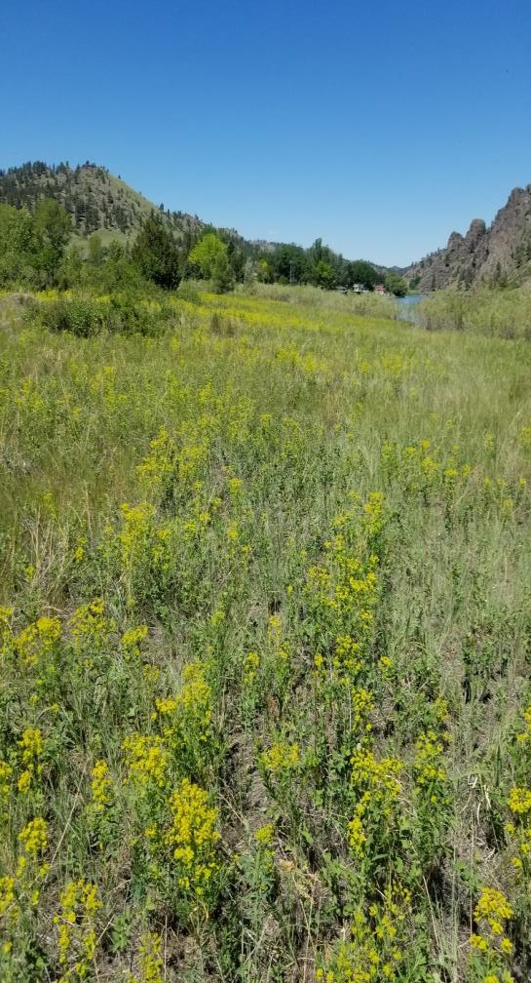
2025 Treatment Plan
Treat 1144 acres
Islands - Holter Dam to Cascade Bridge by boat/backpack
Landowner treatments
  Aerial/Drone
  UTV
  Spot treatments
Volunteer weed pull
Biocontrol agents
Revegetation
Survey and monitor
Grant Request:
$57,485
  Eagle Island Before/leafy Spurge infestation
Eagle Island After (21 acres)

Slide 5
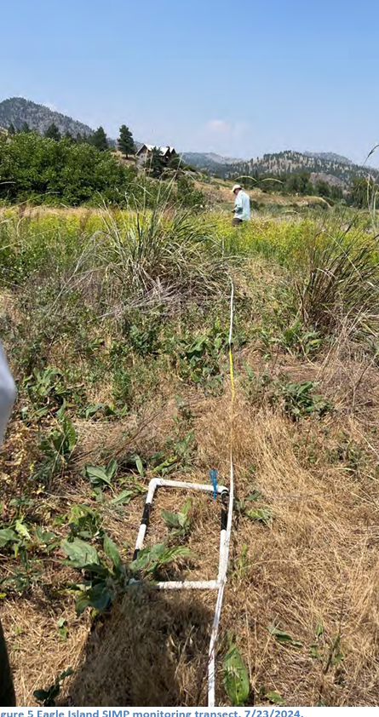
Monitoring and Mapping
Standard Impact Monitoring Protocol (SIMP)
Established 4 permanent sites
Record plant properties
Record bio control agents
Picture Points
Changes in plant populations
EDDMaps West
Field records/new invasives
Educate new users
Arc/GIS
Map treated areas
Map infestations
Incorporate data points
Include landownership

Slide 6
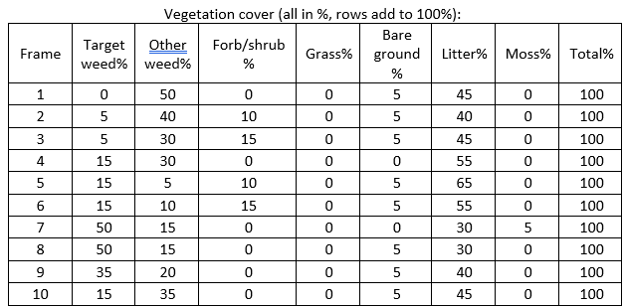
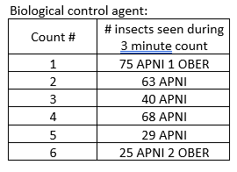
Bio Control
SIMP Data
Expand Releases

Slide 7
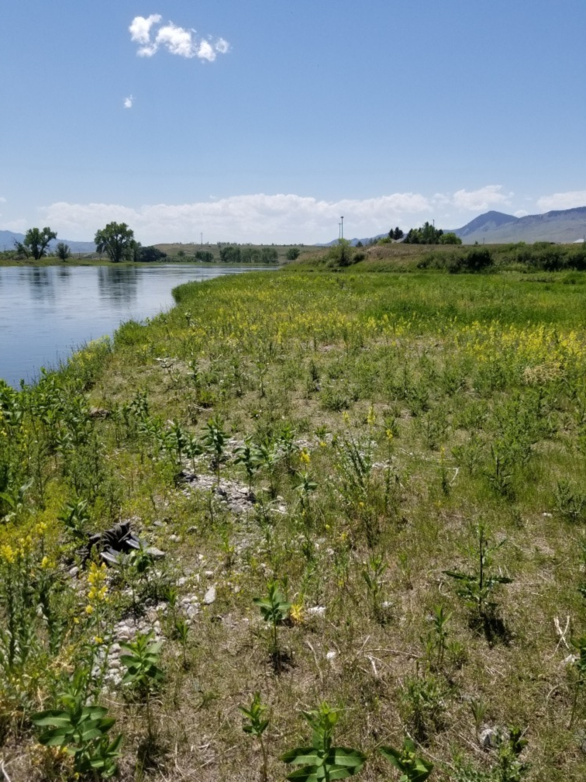
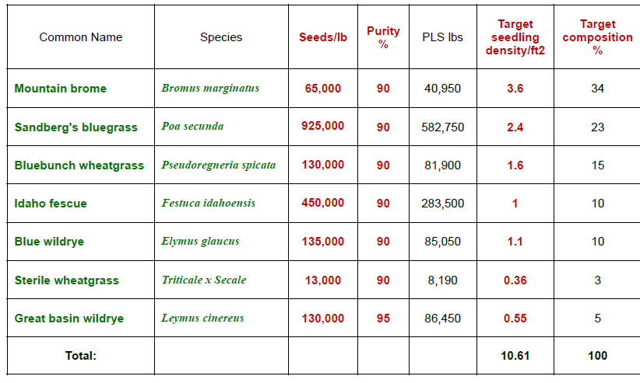
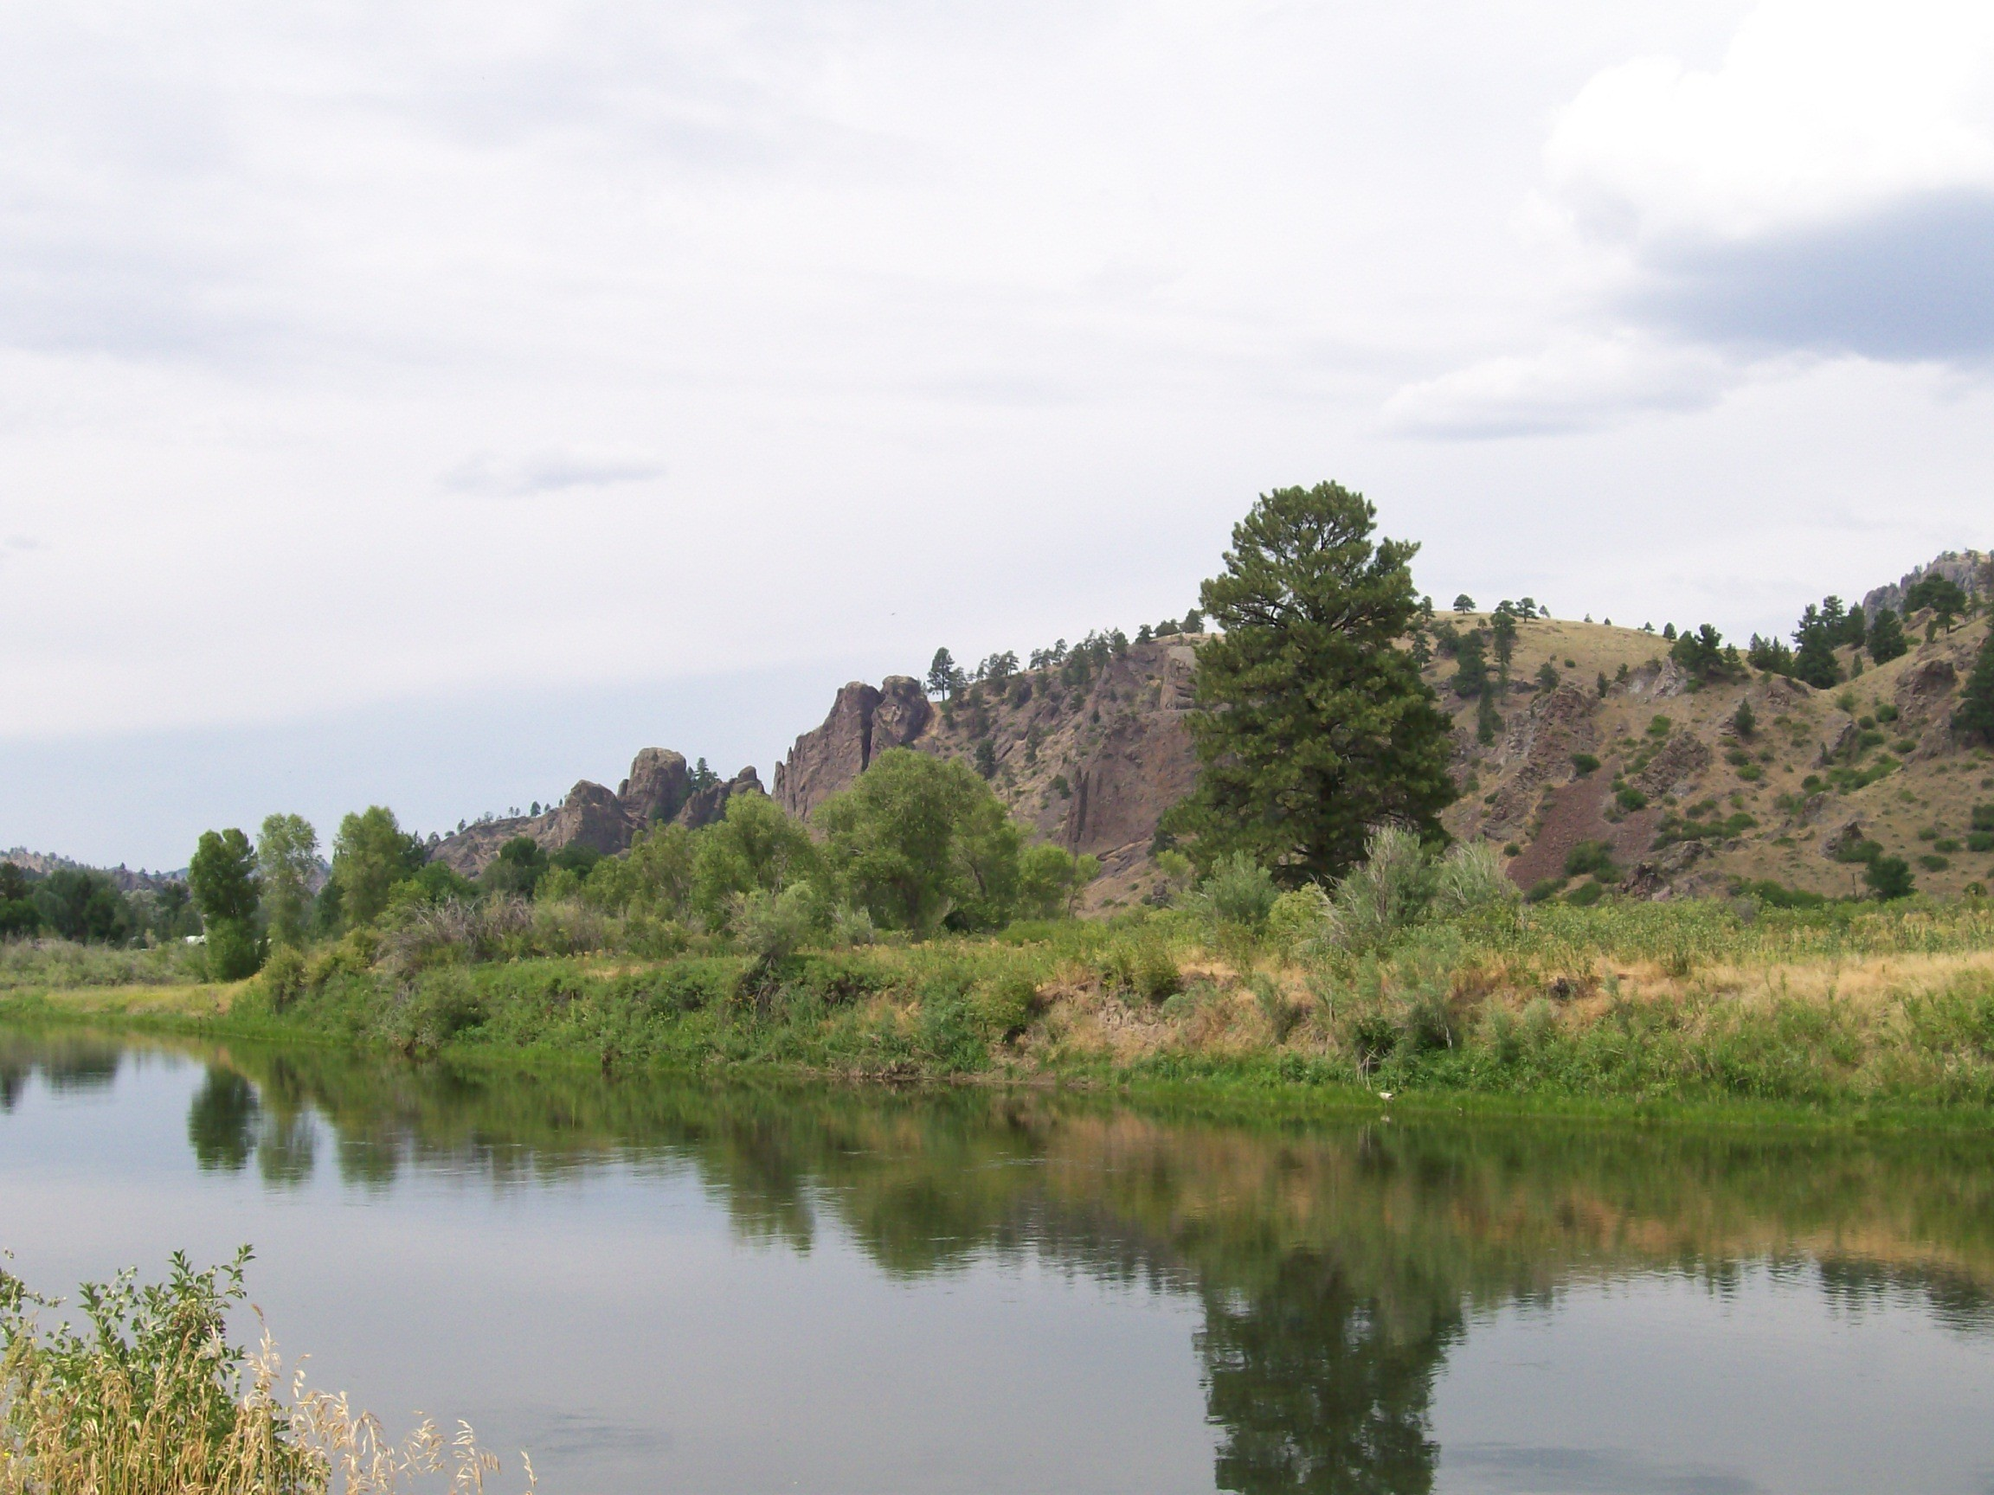
Revegetation Mix
IPNF CdA Nursery
Eagle Island (21 acres):
Map treated areas
Map reseeded areas/test plots
Collect SIMP data
Photograph vegetative changes

Slide 8
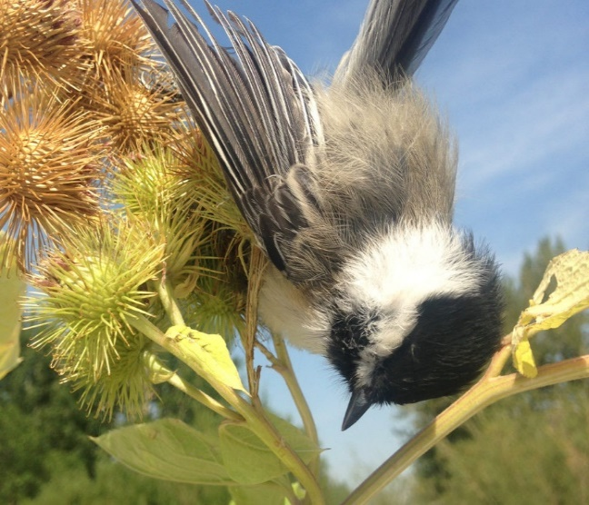
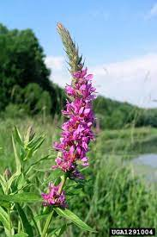
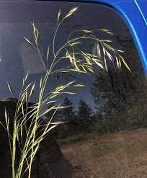
Education
Early Detection/Rapid Response
Social Media Campaign (Facebook, Instagram)
Landowner meetings
Fishing Guides/Outfitters
Fly Shops (Craig, Wolf Creek, Cascade, Helena)
Local Businesses and Community Events
Outdoor Groups (TU, Great Falls High School, Scouts of America)

Slide 9
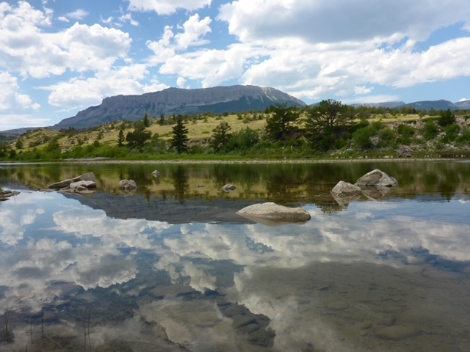
Partners
Upper Missouri Watershed Alliance
Lewis and Clark and Cascade County Weed Districts
Lewis and Clark Conservation District
MT Fish, Wildlife and Parks
USDA Forest Service, IPNF CdA Nursery
Sterling Ranch, OxBow Ranch, Devil’s Kitchen Ranch, Dana Ranch, Wilo Ranch,
Canyon Cattle Co, Mortag Ranch, Dearborn Ranch
Headhunters, Montana Trout, Cross Currents, Wolf Creek Angler, The Trout Shop
West River Land Management, Helena Weed Control, Red Iron Air
NorthWestern Energy

