Slide 1
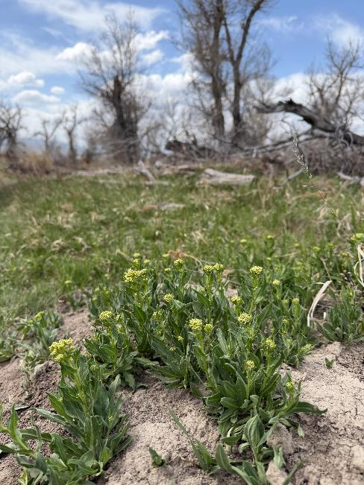
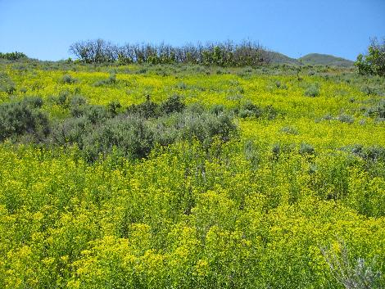
Noxious Weed Educational Gathering
What can we do to keep landscapes we cherish along the Smith and Missouri Rivers from being overrun by Noxious Weeds?
C Weeda 4-26
MTAGDRONES.Com
Sponsored by UMOWA in collaboration with Chestnut Valley and Smith River Habitat Project weed cooperatives

Slide 2
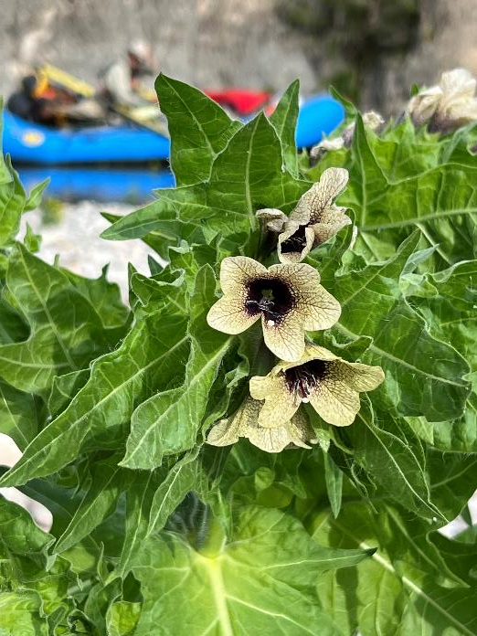
What is a Weed?
“A plant out of place.”-W.S. Blatchley (1912)
“A plant whose virtues have not yet been discovered.” –Ralph Waldo Emerson (1866)
“Plants obstructing the activities of man.” –Dr. John W. Consumptive (18th Century)
“A plant not valued for use or beauty, growing wild and rank, and regarded as cumbering the ground or hindering the growth of superior vegetation.” -William Shakespeare (~1600)
C RANDALL 2022

Slide 3
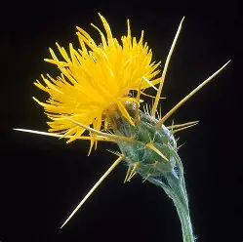

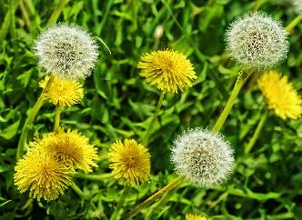
Noxious vs. Obnoxious Weeds
Noxious weeds are designated by a regulatory agency- and by law land managers / owners must manage these plants
Obnoxious weeds are plants which can invade a site, but which are not considered enough of a threat to merit regulation
Yellow
Starthistle
MT 1A Nox
Weed
CABI.org
image
Dandelion- Obnoxious Weed- PIXABAY image

Slide 4
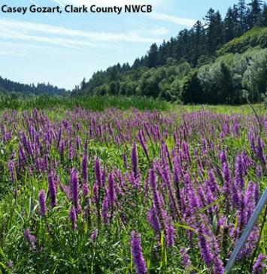
Why Manage Noxious Weeds?
Noxious weeds have the potential to:
  Destroy wildlife habitat
  Reduce recreation opportunities
  Displace threatened and endangered species
  Reduce plant and animal diversity
  Disrupt waterfowl and migratory bird flight patterns and nesting habitats
  Cost millions of dollars in treatment and loss of productivity to private landowners
  Managing Noxious Weeds is the Law

Slide 5
Montana Dept of Agriculture Noxious Weeds
Priority 1A- not present or have a very limited presence in MT; yellow starthistle, dyer’s woad, common reed, medusahead
Management criteria will require eradication if detected, education, and prevention
Priority 1B- limited presence in MT; knotweeds, purple loosestrife, rush skeletonweed, Scotch broom, blueweed
Management criteria will require eradication or containment and education
Priority 2A- common in isolated areas of MT. Management criteria will require eradication or containment where less abundant. Management shall be prioritized by local weed districts
Priority 2B- abundant in MT and widespread in many counties. Management criteria will require eradication or containment where less abundant. Management shall be prioritized by local weed districts
Priority 3- NOT NOXIOUS- but Regulated- can have significant negative impacts, e.g. cheatgrass.

Slide 6
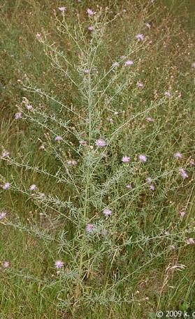
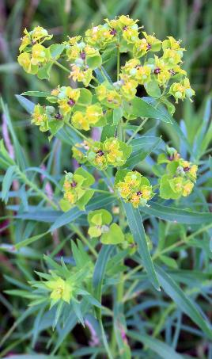
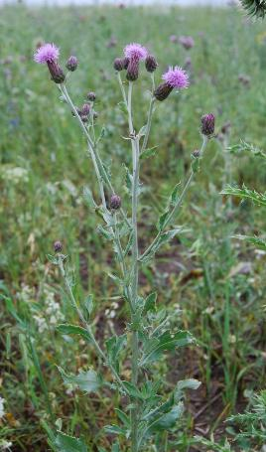
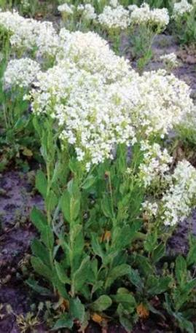
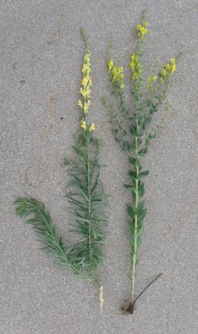
Five MT Noxious Weeds: Smith and Missouri River

Slide 7
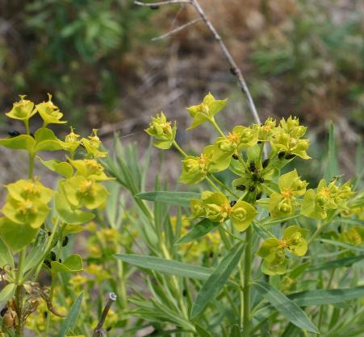
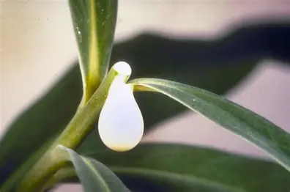
Leafy Spurge
Perennial known for aggressive growth, extensive root system, and toxic milky sap
1-4’ tall, narrow leaves, yellow-green bracts mistaken for flowers
Reproduces vegetatively through crown and root buds, or by seeds – up to 140 seeds per stem that can be ejected 15’ from parent plant.
Seeds viable up to 10 years; roots can extend 15-30’ deep and 15’ wide

Slide 8

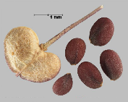
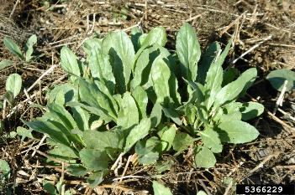
Whitetop (Hoary Cress)
Deep rooted perennial invasive mustard weed up to 2’ tall
Leaves lance-shaped, grayish-blue; basal leaves form a rosette
Dense clusters of small white flowers with 4 petals bloom late spring/ early summer (may bloom again late summer/ fall)
Seeds inflated, heart shaped pods; each stem can produce 1,200-4,800 seeds- viable 3-4 years
Deep roots with extensive rhizomes spreading 12-30 feet
Contains glucosinolates toxic to cattle

Slide 9
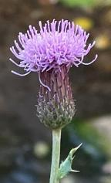
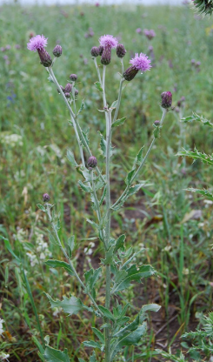
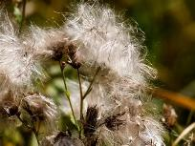
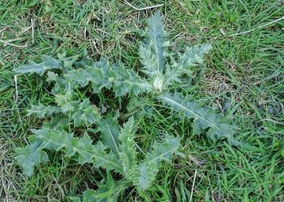
Canada Thistle
1-5’ tall perennial broadleaf weed with upright, grooved smooth or slightly hairy stems
Leaves oblong to spear-shaped, spiny along the edges, and covered with short bristly hairs
Flowers purple, pink, or occasionally white, mid summer to early fall
Spreads through seeds and vegetative root growth; each plant can produce 1,500-5,300 seeds with pappus. Seeds stay viable up to 20-30 years.
Seedlings form a basal rosette before elongating
Root system extensive, growing up to 6’ deep and 15 feet horizontally, with rhizomes capable of producing new shoots

Slide 10
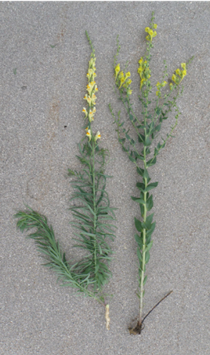

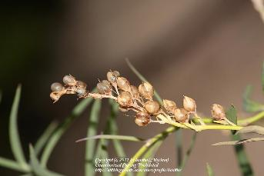
Toadflax
Yellow toadflax and Dalmatian toadflax are invasive perennials
Yellow toadflax has lance shaped, gray-green, 2 –inch long, stalkless leaves; pointed at both ends
Dalmatian toadflax broad heart- or egg- shaped leaves, often clasping the stem
Both have erect stems 7-35 inches tall, smooth, hairless, with branching in the upper half
Flowers yellow snapdragon-like, blooming June- fall
Seedpods are egg-shaped, containing numerous flat, winged seeds
Spread via seeds and creeping root fragments. Roots extend 4-10 feet deep and s10’ horizontally, both toadflaxes can regenerate from root fragments

Slide 11
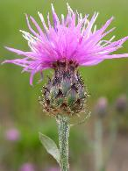
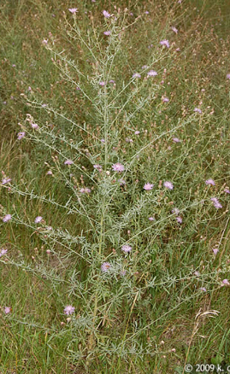
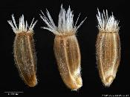
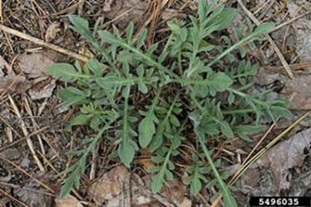
Spotted Knapweed
Invasive perennial (3- 9 years), 2-5 feet tall, that forms dense stands
Has a stout taproot and hairy, rough stems that may appear woolly
In the first year forms a basal rosette of deeply lobed, grayish-green leaves; second year it produces erect, then branched stems with smaller, less lobed leaves towards the top
Flower heads are solitary with pink to purple (occasionally white) thistle-like flowers; the bracts at the base have black-tipped, comb-like fringes, giving the flower a spotted appearance
Spotted knapweed reproduces exclusively by brownish, oval, ¼ inch long seeds, producing thousands per plant, which can remain viable for up to 7-8 years

Slide 12
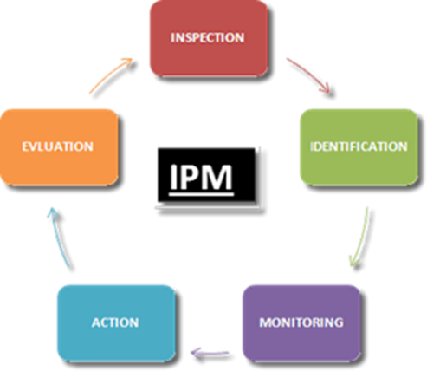
Integrated Pest Management

Slide 13
Integrated Pest/ Weed Management (IPM/IWM)
A strategy to prevent and suppress pests with minimum impact on human health, the environment, and non-target organisms -Steve Dreistadt- UC IPM
Focuses first on PREVENTING problems
Involves
  Inspecting areas thorough time, especially areas susceptible to- or recently treated for- weed invasion,
  Identifying weeds present, Monitoring the weeds, and
  once the weeds are impacting management objectives- choosing ONE or a COMBINATION of management Actions to keep weed populations at acceptable levels,
  Evaluate management activity and adjust as necessary
First discussed in 1959 as a tactic to help reduce reliance on pesticides

Slide 14

If/ When/ and How to Treat?
Pesticide
Inspect- Identify- Monitor
Is Treatment Necessary?
Type/ Scope/ Timing of Treatment Tactic(s)
  Cultural
  Physical
  Biological
  Pesticide
Evaluating Treatment Effectiveness- Revising Treatment Strategy
Biological
Treatment Tactics
Physical
Cultural
PREVENTION
Notes:
The only place on the invasion curve where managers consider NOT treating is in Asset Based Protection- even in the containment phase treatments are being used to eradicate satellite populations

Slide 15
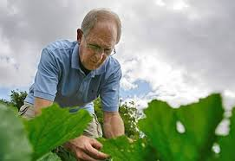
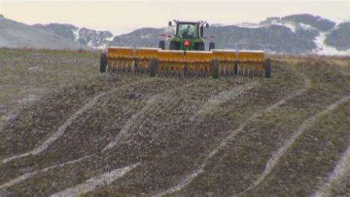
Cultural
A key component of prevention
Cultural treatments keep plants healthy (VIGOROUS), healthy plants can resist invasion
Cultural treatments include:
  Soil Care
  Revegetating
  Grazing
  Sanitation
  Minimizing disturbance
Works by making it tough for weeds to dominate- won’t see dead/ dying target weeds but will see more desirable vegetation and target weeds will be suppressed

Slide 16
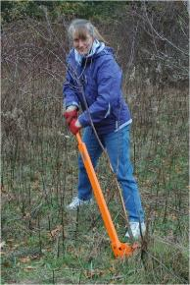
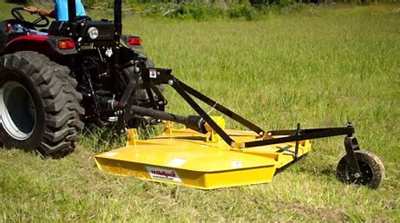
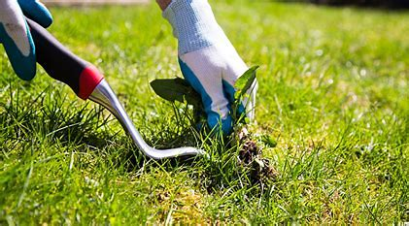
Physical/ Mechanical
Another type of treatment that works preventatively
Remove weeds, with hands or hoe
Mow weeds to prevent flowering
Remove flower heads to prevent seed set
See results immediately; however, results may not last

Slide 17
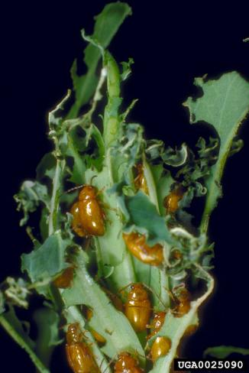
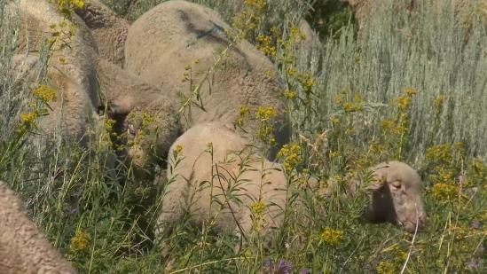
Biological
Use natural enemies, including the host specific natural enemies in classical biocontrol, to keep weed populations suppressed
Results not readily apparent, works through time
Monitoring is key to recognizing success

Slide 18
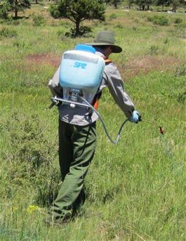
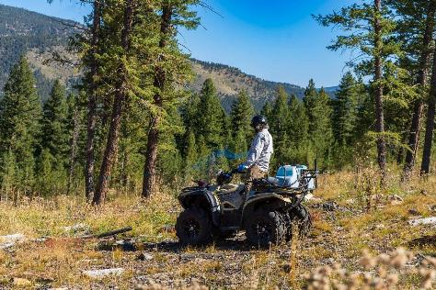
Pesticides
Use of herbicides to directly control weeds
Impact visible in days to weeks, but often must be repeated as new weeds germinate or damaged weeds resprout
Does not address underlying cause for landscape susceptibility to weeds
Needs to be done with careful consideration of potential non-target effects on desired plants

Slide 19
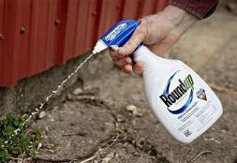
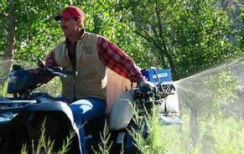
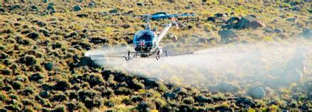
Scope of Treatment
Monitoring efforts will help you define the extent of the weed problem
Treatment should be in line with weed problem, especially if using an herbicide that effects desired plant species
Spot treatments of individual weeds may be more effective than a blanket application

Slide 20
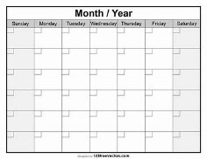
Timing of Treatment
Treat when treatment will have an impact on weed, but before weed has caused unacceptable damage
Especially important for mechanical and herbicide treatments
Need to be monitoring weeds and evaluating treatment effects
If mechanical or herbicide treatments are used, need to revisit and monitor the site to ensure the weed population has not rebounded- be prepared to re-treat if necessary
If biocontrol agents are released, need to know if biocontrol agents are present on site (monitoring) and be prepared to re-release if populations are low

Slide 21
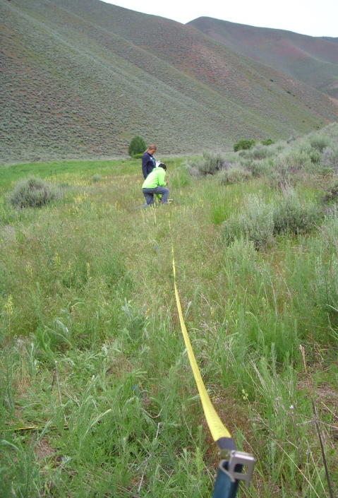
Evaluating Effectiveness
After treatment, you should be able to answer the question
“Did it work?”
Post treatment monitoring is key to IPM
If treatment strategy did not achieve its goals, why not?
  Did weeds come back from a seedbank?
  Did biocontrol agents fail to establish on site?
How can you revise the treatment strategy to achieve a better result?
WHAT COMES NEXT?

Slide 22
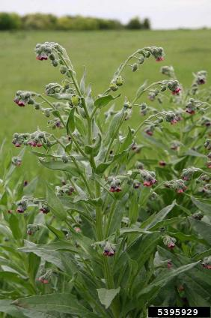
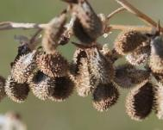
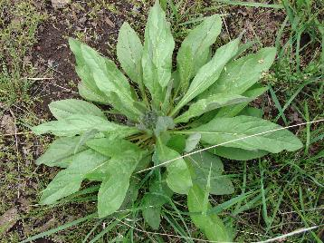
Houndstongue
Non-native, invasive, and poisonous weed- toxic to livestock, containing pyrrolizidine alkaloids that damage the liver
Biennial or short-lived perennial; rosettes in the first year, then a tall (1–4 ft) erect stem in the second
Leaves: Alternate, lance- to oblong-shaped, 1–12 in long, 1–3 in wide, sharply pointed, hairy, and often dusty
Flowers: Reddish-purple (sometimes white), drooping from dense panicles; 5 rounded petals with long white hairs
Seeds: Barbed nutlets (0.5 in long) that cling to fur, wool, and clothing, earning names like “beggar’s lice” and “sheep bur”
Root system: Thick, dark, woody taproot up to 3–4 ft deep
Reproduction: Seed-only reproduction; each plant can produce up to 2,000 seeds, viable for 2–3 years

Slide 23
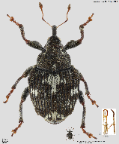
Biocontrol from Across the Border
Mogulones crucifer (Coleoptera: Curculionidae) is a European, root-feeding weevil that is not native to the United States
Canada began releasing Mogulones crucifer as a biological control agent for houndstongue in 1997; however, because these weevils may feed on federally protected and non-targeted plants in environmentally sensitive areas of the United States, releasing them here could have serious ecological repercussions and is PROHIBITED
The weevils are crossing the Canada/ U.S. border

Slide 24
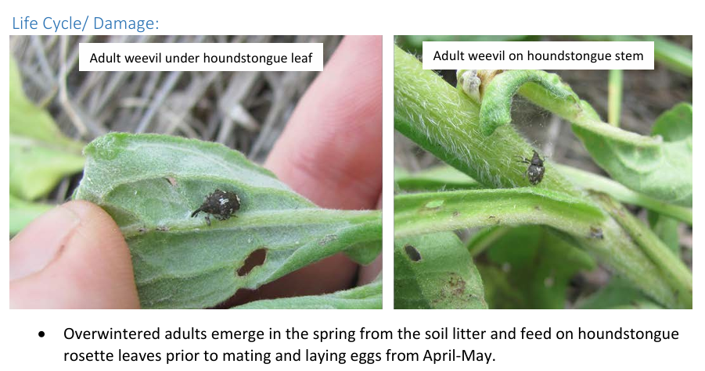

Slide 25
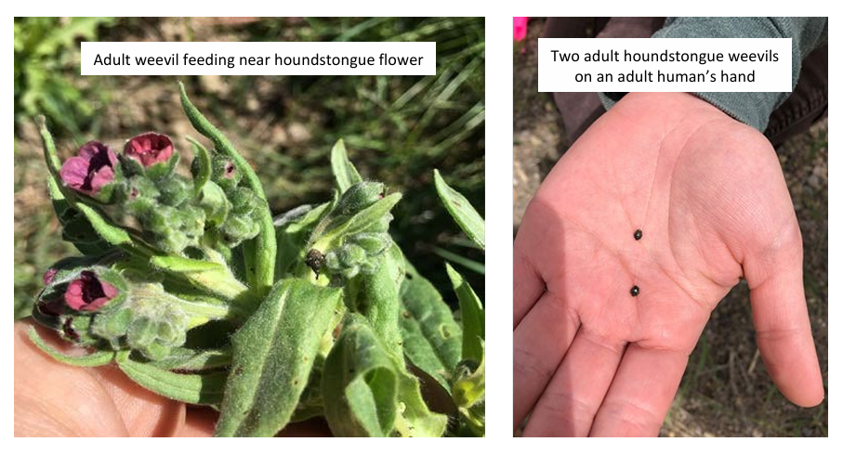

Slide 26
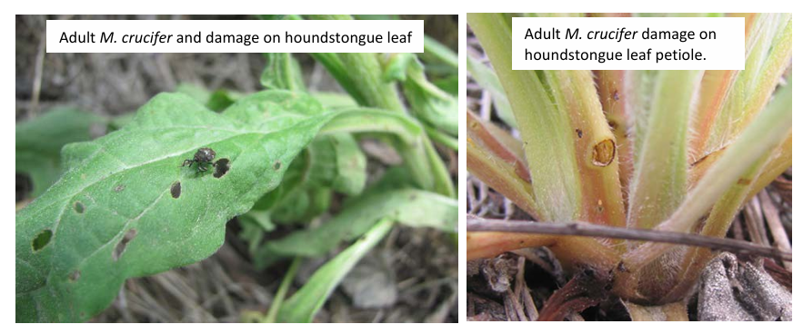

Slide 27
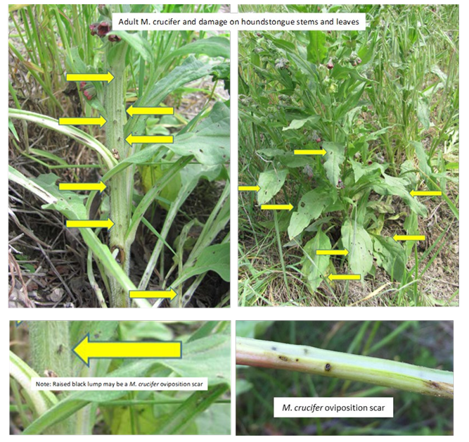

Slide 28
